Slide 1
On the Design and Scalability of Distributed Shared-Data Databases
Amit Thakral (A20343683)
Kedar Kaushikkar (A20355218)
Pooja Mankani (A20354444)

Slide 2
Introduction
Presentation focuses on:
Alternative architecture design (Shared data architecture) for distributed relational databases
Comparison of Partitioned and Shared Data architecture
Tell as a shared data database
Techniques for efficient and consistent data access using Tell
Experimental evaluation
Conclusion

Slide 3
Motivation
Why Shared data architecture?
To overcome limitations in partitioned databases
Limitations of Partitioned database?
Inflexibility towards large scale deployments
Defining the workload size based on the partition
Drawback of shared data architecture and ways to overcome?
Synchronization overhead while accessing data from multiple nodes
Efficient data access, concurrency control and buffering

Slide 4
Shared-Data Architecture
What is shared data architecture?
Data is shared and accessed across all database instances
Database instances do not own a specific partition but access the whole data
Fundamental Principles
Data sharing across all database instances
Decoupling query processing and transaction processing from data storage
Advantages
No complex DB Cluster
Partitioning not dependent on application logic hence database is simplified
Provides operational flexibility
Disadvantages
Updates in the data need to synchronized across instances
Data access between instances require network communication

Slide 5
Shared Data Architecture - Design Principles
Data accessible across all database instances
Decoupling of Query Processing and Storage
Decomposed into two logically independent layers:
Transactional processing layer
Data storage layer
In memory storage
Provides Low Latency
Avoids complex buffering mechanisms
ACID transactions
Performed on the processing layer
Complex Queries
Query processing (Processing layer) -> Data access (Storage layer)

Slide 6
Shared v/s Partitioned database
Client 1
Client 2
Client 3
Client 1
Client 2
Client 3
Applications
Applications
Applications
Applications
Applications
Applications
Databases – Processing Layer (Query Processing & Transaction Management)
Storage Layer
Databases – Processing Layer (Query Processing & Transaction Management)
Storage Layer
Databases – Processing Layer (Query Processing & Transaction Management)
Storage Layer
Databases – Processing Layer (Query Processing & Transaction Management)
Storage Layer
Databases – Processing Layer (Query Processing & Transaction Management)
Storage Layer
Databases – Processing Layer (Query Processing & Transaction Management)
Storage Layer
Processing Layer
Data 1
----------------------
Data 2
----------------------
Data 3
----------------------
Data 1
----------------------
Data 2
----------------------
Data 3
----------------------
Storage Layer
Partitioned Database
Shared-data Database

Slide 7
Shared Data Architecture
Technical Challenges
Data access across multiple instances
Indexing
Consistency maintenance across all the instances with indexes
Concurrency Control
Inconsistency across all instances due to network latency
Limitations
Low latency communication
Limited buffering & Heavy data access over network
Synchronous replication
High communication cost between data centers
Network Saturation due to large records

Slide 8
Tell – A shared data architecture
Major components of Tell
Processing Node (PN)
Management Node (MN)
Storage Node (SN)
Concurrency control
allows transactions to run in parallel on multiple (PNs)
Distributed Snapshot Isolation
Multi version concurrency control protocol
Commit Manager
Manages the global snapshot information
Processing Node
Application Logic, Query Processing, Transaction Management, Node Management, Buffer, Storage Interface
Management Node
Processing
Commit Manager
Get / Put
Byte[]
Distributed Storage System
Schema, Data, Indexes, Transaction Log
Storage
Components in Tell architecture

Slide 9
Tell – A shared data architecture
Transaction life cycle:
Begin
Running
Try-Commit
Commit
Abort
Begin – Contact the commit manager
Running – Access or update an item
Try-Commit – Log the updated item for failure recovery (Apply LL/SC operations)
Commit – Updates are applied
Yes
Success?
No
Abort – Updates are rolled back
Transaction life cycle

Slide 10
Tell – A shared data architecture -- Recovery and Fail over
Processing node
PN works on a crash stop model.
Failure detected -> transactions aborted
Recovery initiated to rollback transactions
Storage node
Handled transparently
Failure of storage node must not lead to data loss
Data availability guaranteed by data replication
Commit manager
Single commit manager -> wide system impact ; Multiple -> no major impact
Active transactions committed -> new commit manager started
State information recovered using last used TID

Slide 11
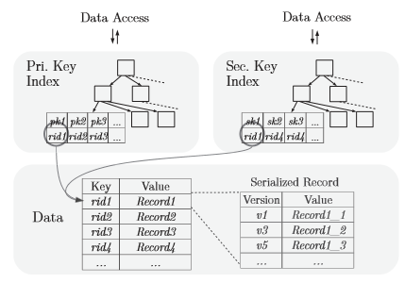
Data access and Storage in Tell
Data access
Tell architecture provides a SQL interface
Data mapping
Record is stored as one key-value pair
Mixed Workloads
Indexing
Efficient way for lookup to identify the matching records for a given attribute.
Tell uses a latch-free B+ tree as its structure
 | OLTP | OLAP
 | Short running queries | Long running queries
 | Parallized over PN | Full table scan by PN
Mixed workload | Simple operations (Selection / Projection) in SN Complex processing in PN
Storage and access of data records

Slide 12
Data access and Storage in Tell
Garbage Collection : Prevent data items from growing infinitely
Eager
Lazy
Buffering techniques
Transaction Buffering
Operate on a particular snapshot
Does not require the latest version of a record
Shared record Buffering
Caching layer between the transaction buﬀers and the storage system
Version number set is compared with the transaction’s snapshot descriptor
Shared Buffer with Version Set Synchronization
Similar to shared record buffering but the version number is synchronized using storage system

Slide 13
Experimental Evaluation
Benchmarking environment Specification
Experiments performed
Parameter | Specification
Processor | 12 servers each with two quad core Intel Xeon E5-2609 2.4 GHz 2 processors per server
RAM | 128 GB DDR3
SSD | 256 GB Samsung 840 Pro
Network | 40 Gbit QDR InﬁniBand
Evaluation Parameter | Experiment
Scale Out | Performance of Tell on scaling PN, SN and Commit Manager
Partitioned Database | Comparison of performance of Tell v/s MySQL and VoltDB
Network | Comparison of InfiniBand v/s 10 GB Ethernet to achieve high throughput on Tell
Buffering Strategies | Comparison of performance using different buffering strategies

Slide 14
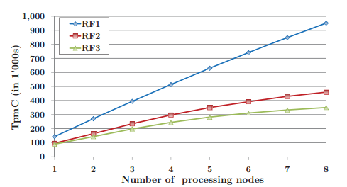
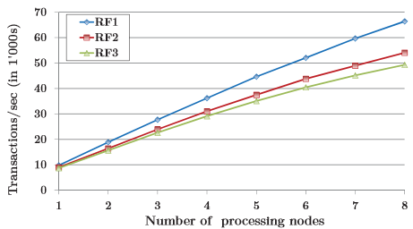
Experimental Evaluation
Experiment | Input | Output
Processing Node | Increase number of processing node Replication factor from 1 to 3 Task : Write intensive | Throughput increases as processing nodes increase, but highly dependent on replication factor
 | Increase number of processing node Replication factor from 1 to 3 Task : Read intensive | Throughput increases as processing nodes increase, not highly dependent on replication factor

Slide 15
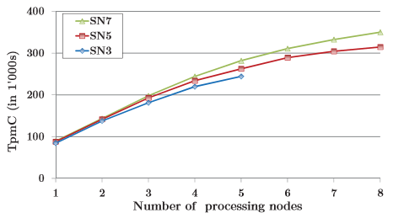

Experimental Evaluation
Experiment | Input | Output
Storage Node | Increase number of storage nodes from 3 to 5 | Throughput increases with increase in number of storage nodes
Commit Manager | Increase number of commit managers | Throughput remains the same as the number of commit managers increase. Hence commit manager is not a performance bottleneck
Scale out Storage (Write Intensive)
Commit ManageR (Write Intensive)

Slide 16
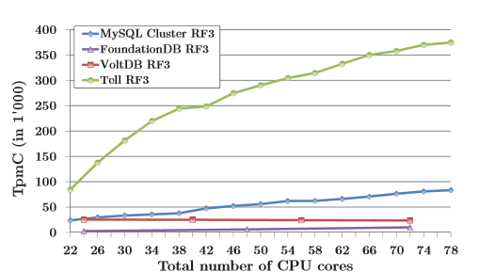
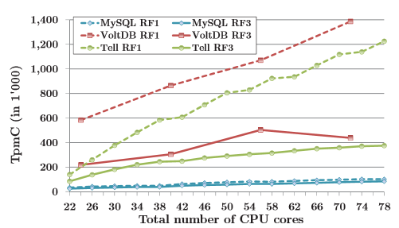
Experimental Evaluation
Experiment | MySQL | VoltDB
Shared v/s Partitioned database | Partitioned database with an in-memory storage engine with management node, data node and SQL node | VoltDB is an in-memory relational database that partitions the data and then serially executes transactions on each of the partition
Experiment 1 | Shared-data architecture shows higher performance than partitioned databases for OLTP workloads that are not fully partitioned
Experiment 2 | shared-data architecture shows competitive OLTP performance. Even with a perfectly partitioned workload, the achieved throughput is in the same range as of partitioned databases

Slide 17
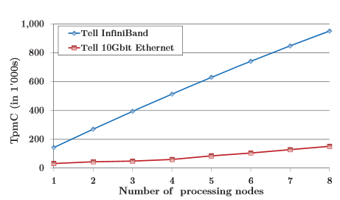
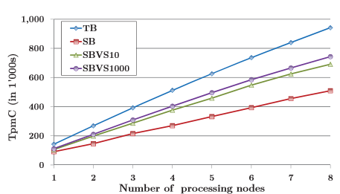
Experimental Evaluation
Experiment | Input | Ouput
Inifiband v/s 10GB Ethernet | Replication Factor =1 Storage Node = 7 Varying number of processing node | InfiniBand Network performs 6 times greater than on Ethernet Network irrespective of the PN used. The difference is in the network latencies. TELL being a synchronous Processing model reduction in latency increases the throughput
Comparison of Buffering strategies | Replication Factor =1 Storage Node = 7 Varying number of processing node | The transaction buffer strategy is found to be best when compared from throughput chart shown above.

Slide 18
Conclusion
TELL decouples Transaction Query Processing into two layers to enable elasticity and workload flexibility.
Distributed record manager is used to store data and shared among all database instances.
TELL provides higher throughput than VoltDB, MySQL Cluster, and FoundationDB in the popular TPC-C benchmark.
Shared data architecture enables high performance irrespective of the workload assumptions thus being elastic.
Operational flexibility can be achieved.
Recovery and fail-over is achieved across all the nodes.

Slide 19
References
J. Baker, C. Bond, J. Corbett, J. Furman, A. Khorlin, J. Larson, J.-M. L´eon, Y. Li, A. Lloyd, and V. Yushprakh. Megastore: providing scalable, highly available storage for interactive services. CIDR’11, pages 223–234, 2011.
M. Cahill, U. R¨ohm, and A. Fekete. Serializable isolation for snapshot databases. SIGMOD’08, pages 729–738, 2008
P. Bernstein and N. Goodman. Concurrency control in distributed database systems. ACM Comput. Surv., 13(2):185–221, 1981.

